Slide 1






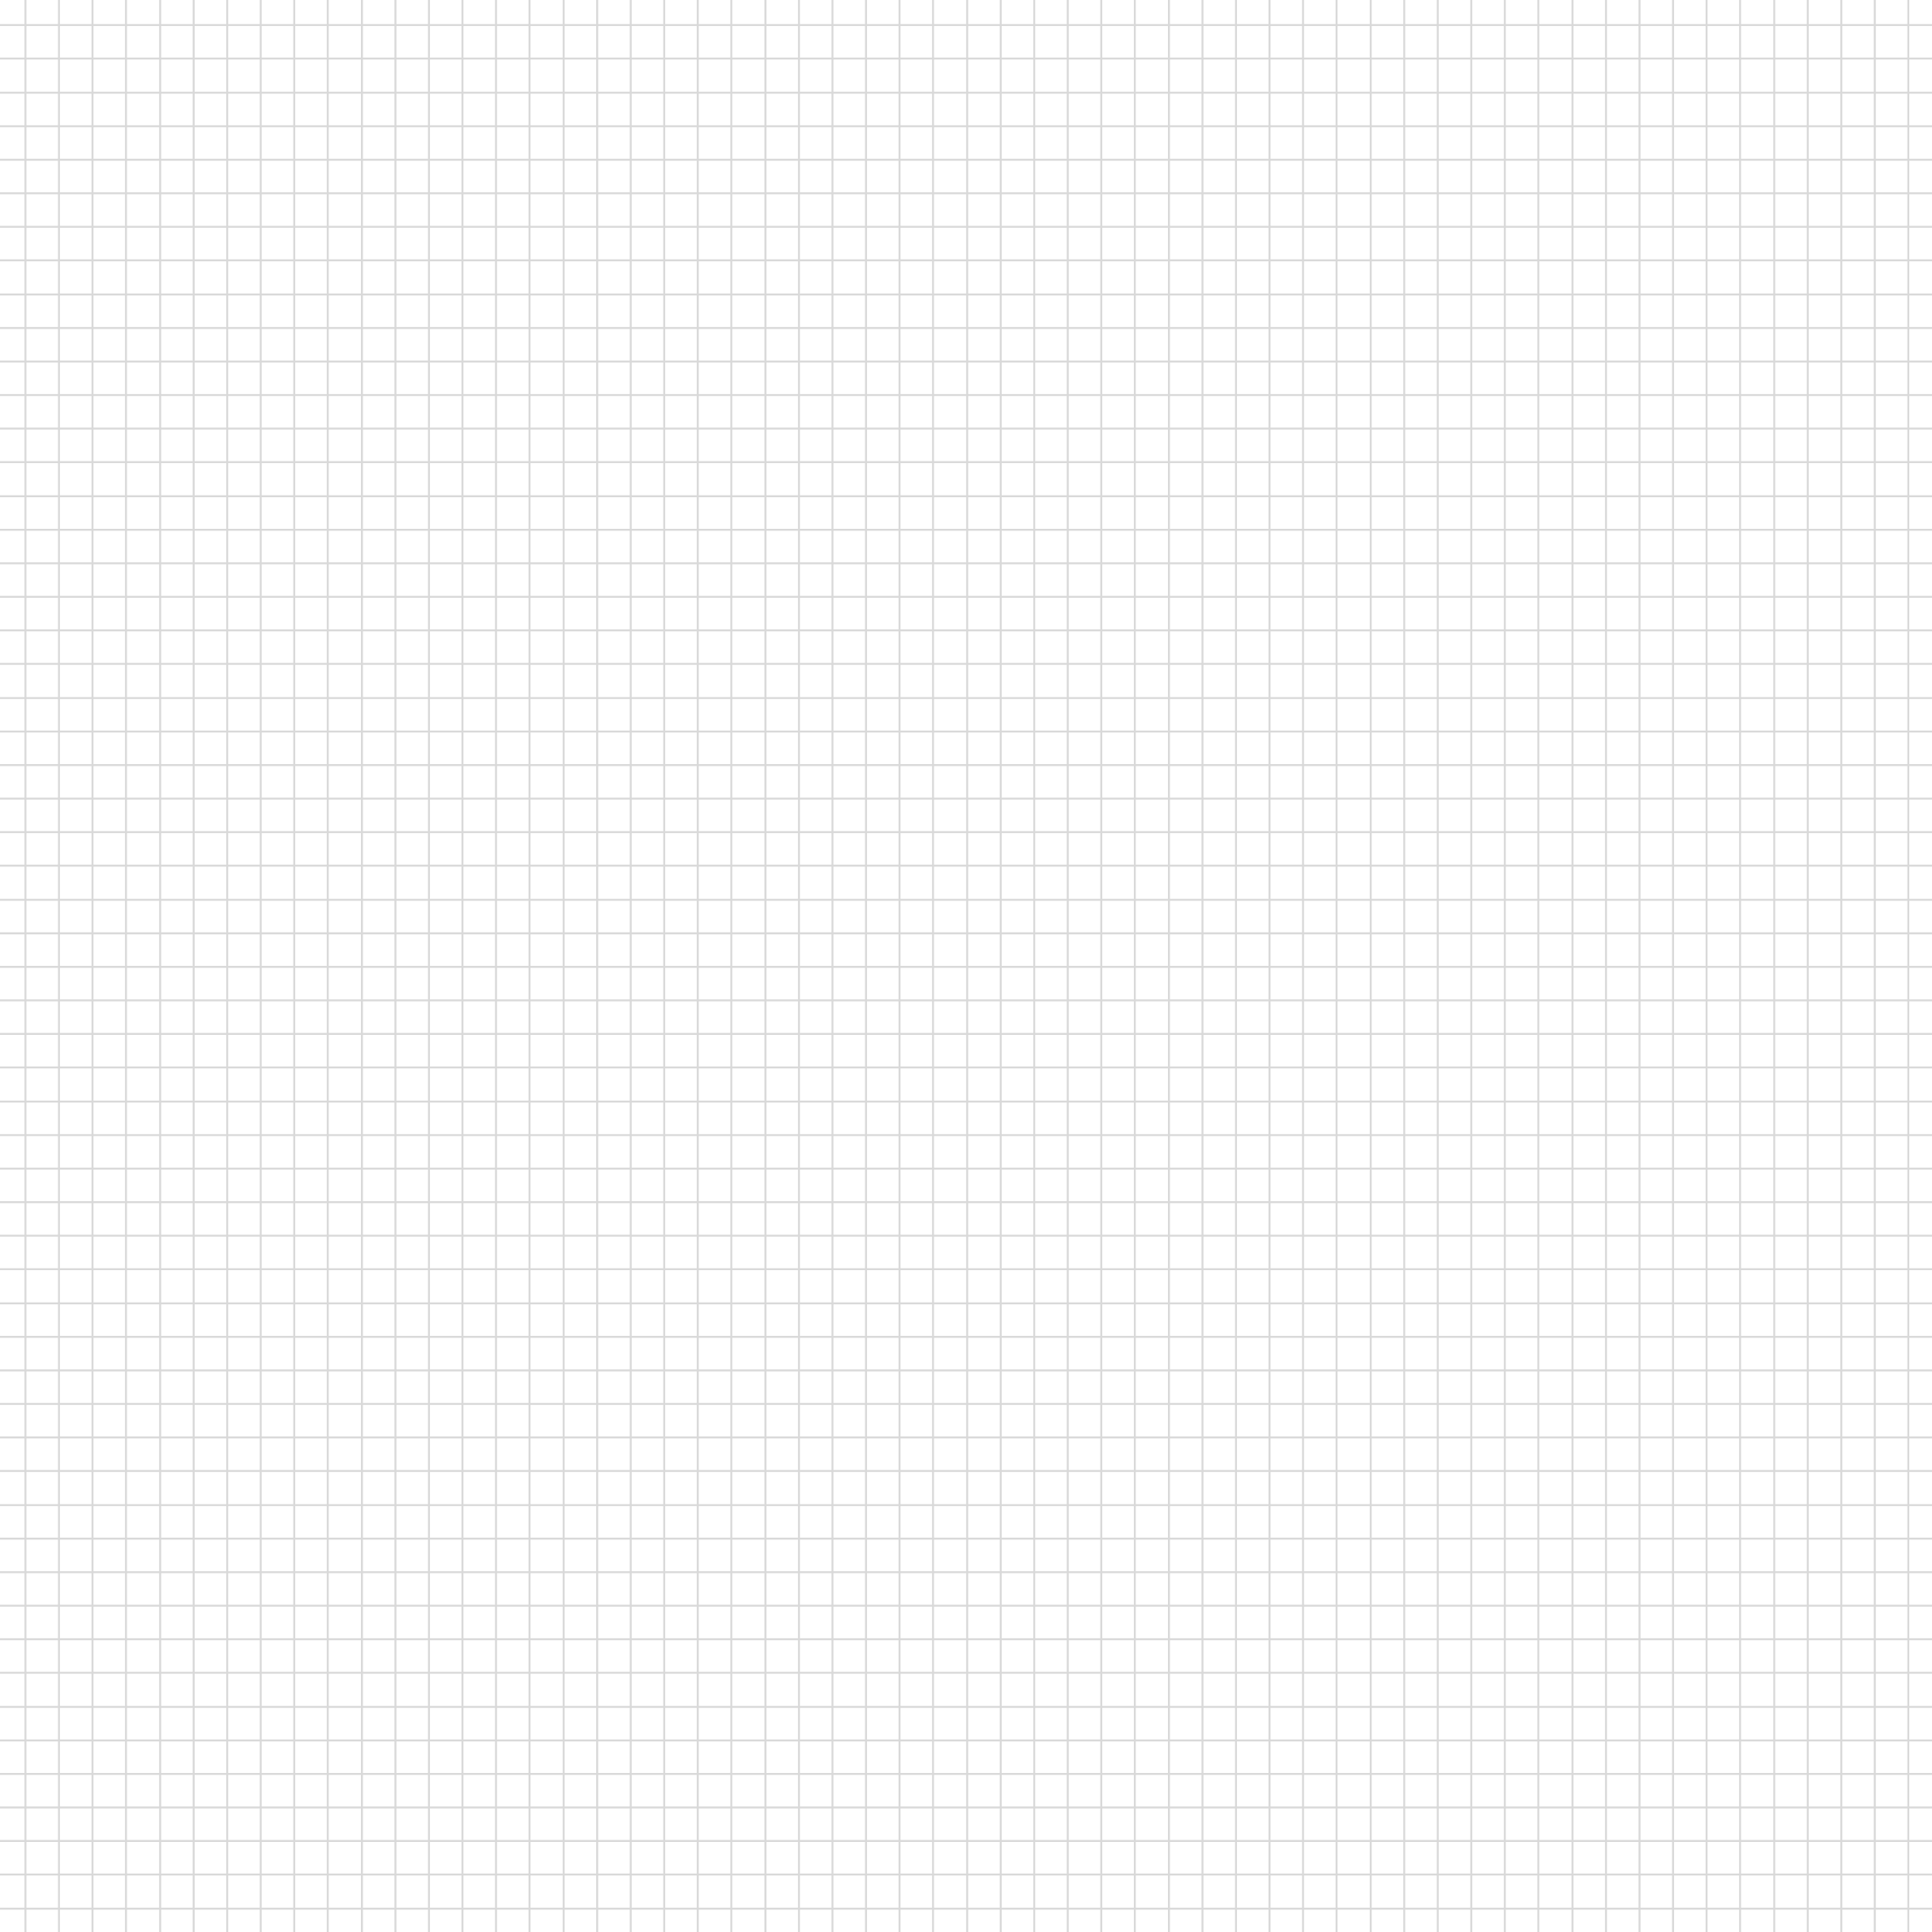






JUTTA
SANSAAR
An E-commerce Website of Footwear Retailing
Gaurav Pandey(231420)
Binod Baduwal(231415)
Yugesh Man Shrestha(231448)

Slide 2




1.
Introduction
2.
Problem Statement
contents
3.
Objectives
4.
Scope and Limitations
5.
Team members and Divided Roles
6.
Methodology
7.
System Design
8.
Testing
9.
Conclusion

Slide 3


INTRODUCTION
The rise of digital commerce has changed how people buy fashion products, including footwear.
Most large e-commerce platforms (like Amazon or Daraz) are not specialized—they serve all kinds of products, making it hard for users to find the right shoes.
Jutta Sansaar is an E-commerce platform where we ease up the Retailing process of Shoes of our desire.
The platform aims to be:
Simple and responsive
Secure and modular
Suitable for men’s, women’s, and children’s footwear

Slide 4


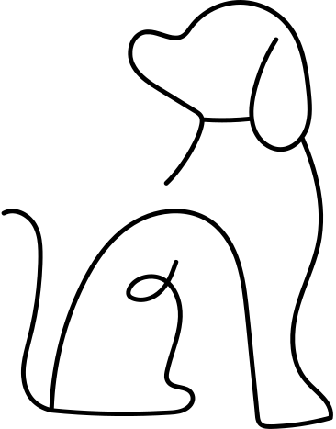
Most popular e-commerce platforms are too general, selling thousands of unrelated products.
Hard for users to filter and find desired shoes.
Problem Statement
Complex navigation for such a specific product category.
Local shoe retailers lack online selling platforms.
Need for a simple, specialized shoe e-commerce system.
Challenges people face while trying to Buy Shoes Online

Slide 5


OBJECTIVES
01
02
03
04
Develop a clean and user-friendly e-commerce platform for footwear retailing.
Design a clean and user-friendly interface to improve the shopping experience.
Provide login, signup, cart, and checkout modules.
Admin panel to manage products and customer orders.

Slide 6



Scopes and Limitations
scopes
limitations
A web-based e-commerce platform designed specifically for footwear retailing.
Supports both Customer Interface (for browsing and purchasing) and Admin Interface (for product and order management).
Users can:
Browse shoes by category, gender, and size.
Add to cart and place orders.
Log in and Log out.
Admins can:
Add, edit, and delete products.
View and manage customer orders.
Accept or reject orders.
No integrated online payment gateway yet
(e.g., Khalti, eSewa planned as future work).
No delivery tracking system implemented.
No dedicated mobile application—currently limited to responsive web use.
No AI-based personalization or recommendations in the current version.

Slide 7


team members and roles
gaurav Pandey
Yugesh shrestha
binod baduwal
UI/UX Design for:
Home page
Product listing
Cart and checkout pages
Session management (Login/logout handling)
Partial database work for index, products, cart, checkout
Documentation writing
UI/UX Design for Admin Panel
Backend work for admin database
Responsible for:
Admin login/logout
Order management system
Created all diagrams:
Use case
Process flow
Schema diagram
Assisted in idea management, logic flow, and integration
Actively participated in team coordination
Helped during development due to unavailability of personal laptop
Contributed to documentation

Slide 8

Methodology:
Incremental Development Model
Why Incremental (Iterative) Model?
Allows step-by-step development and testing of features.
Easy to go back and fix bugs or change requirements.
Suitable for dynamic projects where feedback and improvement are ongoing.
Supports parallel work on different modules (e.g., cart, admin).
Steps Followed in This Project
1. Requirement Phase
Collected functional and non-functional requirements.
2. Analysis and Design Phase
Designed system architecture and database schema.
3. Implementation
Coded frontend (HTML/CSS/JS) and backend (PHP).
Setup database in MySQL.
Developed modules like login, cart, admin panel.
4. Testing
Manual and unit testing of all modules.
5. Evaluation
Verified functionality, usability, and performance.

Slide 9

System Features and Tools used
System Features
Tools used
User registration and login system with sessions.
Product filtering by category and types.
Shopping cart to manage selected items.
Checkout page with order summary.
Admin panel to add, update, delete products and manage orders.
Tools & Technologies used are:
HTML/CSS/JavaScript – Frontend structure and styling.
PHP – Backend scripting and logic.
MySQL – Relational database.
XAMPP – Local development environment.
GitHub – Version control.
VS Code – Code editor.

Slide 10
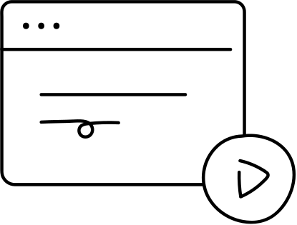
SYSTEM DESIGN
1. System Architecture (3-Tier)
a. Presentation Layer (Frontend):
Technologies: HTML, CSS, JavaScript
Purpose: Interacts with users (customers/admin)
Handles: Product display, navigation, login, cart, etc.
b. Application Layer (Backend):
Technology: PHP
Purpose: Core business logic
Handles: Login validation, cart operations, order processing, admin control
c. Data Layer (Database):
Technology: MySQL
Stores: User info, products, orders, cart items, admin data
2. Use Case Diagram
Shows user interactions with system features
3. Process Flow Diagram
Step-by-step representation of user and admin workflows.
4. Schema Diagram
Shows relationships between tables

Slide 11
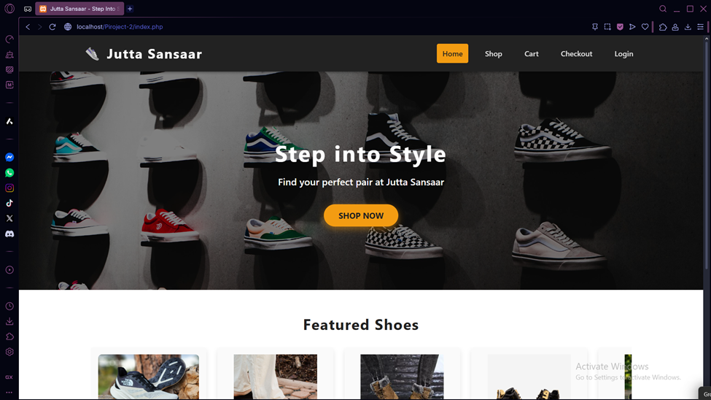
Testing AND DEMONSTRATION
INDEX PAGE

Slide 12
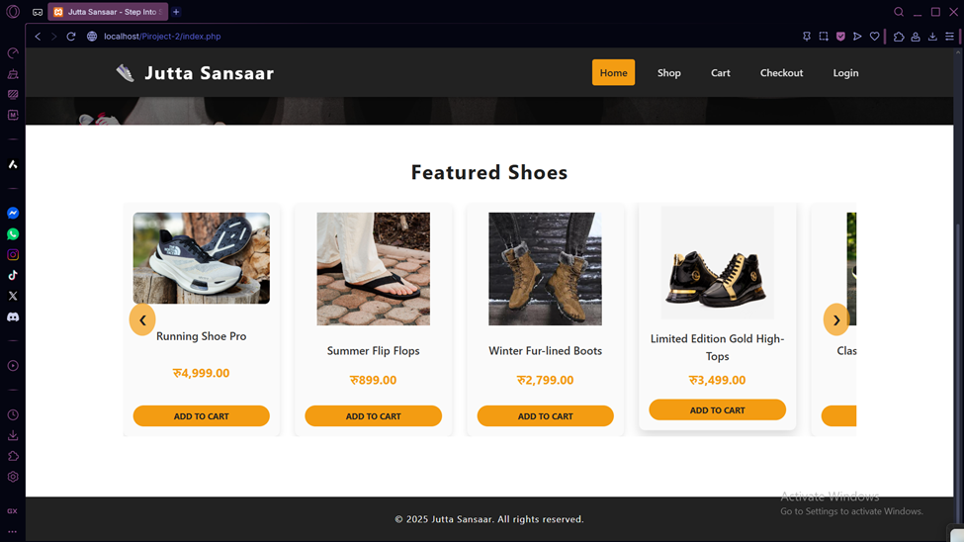
Testing AND DEMONSTRATION
INDEX PAGE

Slide 13
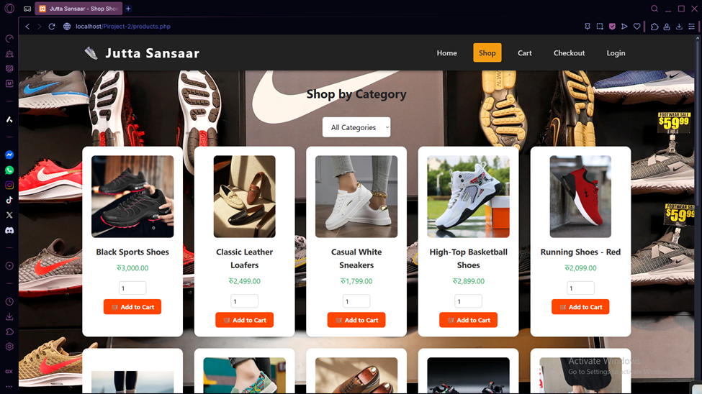
Testing AND DEMONSTRATION
PRODUCTS PAGE

Slide 14
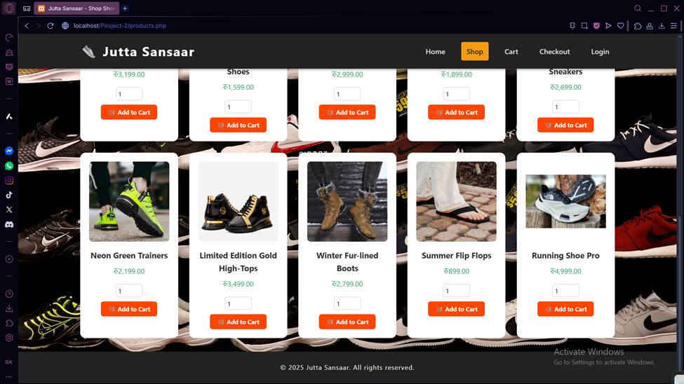
Testing AND DEMONSTRATION
PRODUCTS PAGE

Slide 15
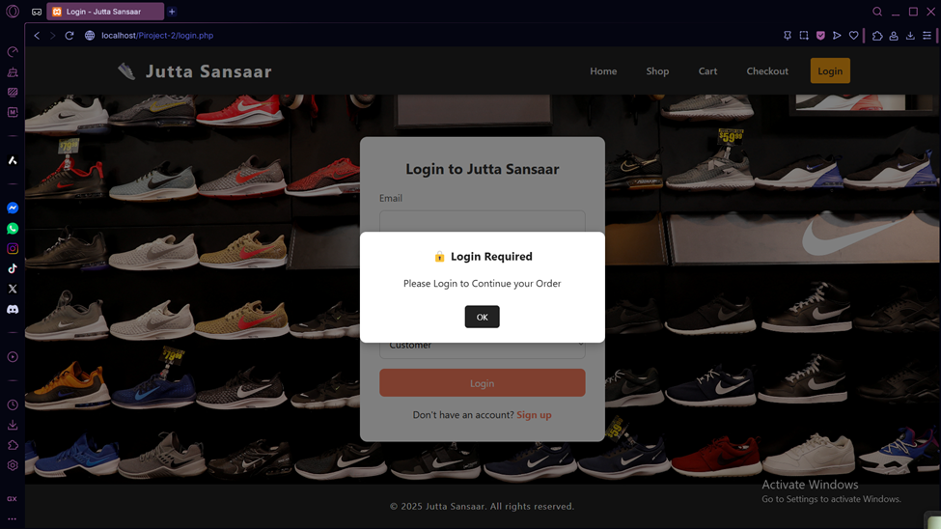
Testing AND DEMONSTRATION
LOGIN PAGE

Slide 16
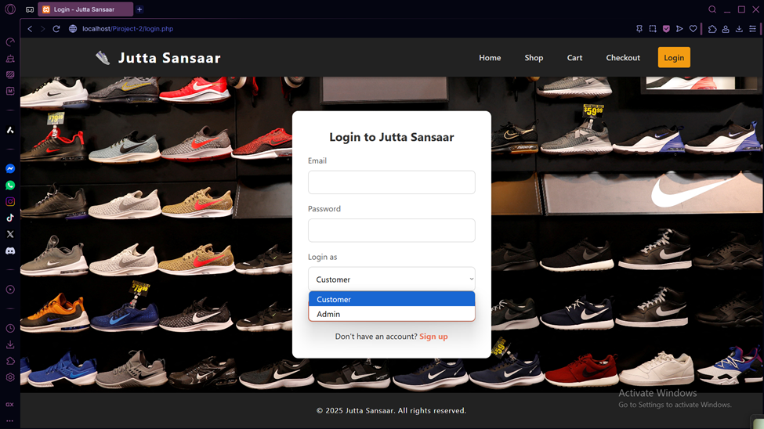
Testing AND DEMONSTRATION
LOGIN PAGE

Slide 17
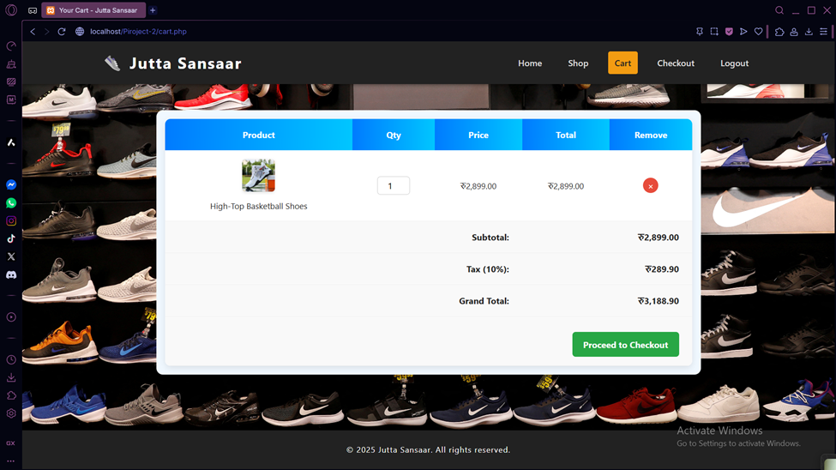
Testing AND DEMONSTRATION
CART PAGE

Slide 18
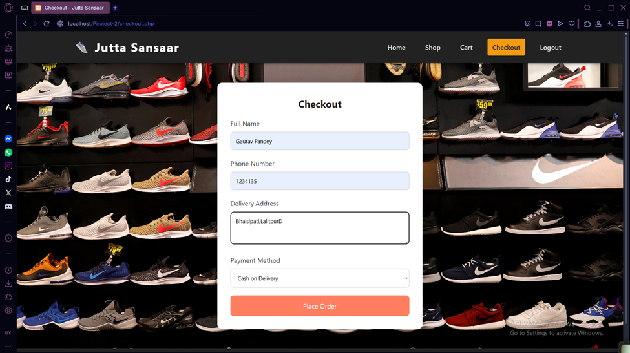
Testing AND DEMONSTRATION
CHECKOUT PAGE

Slide 19
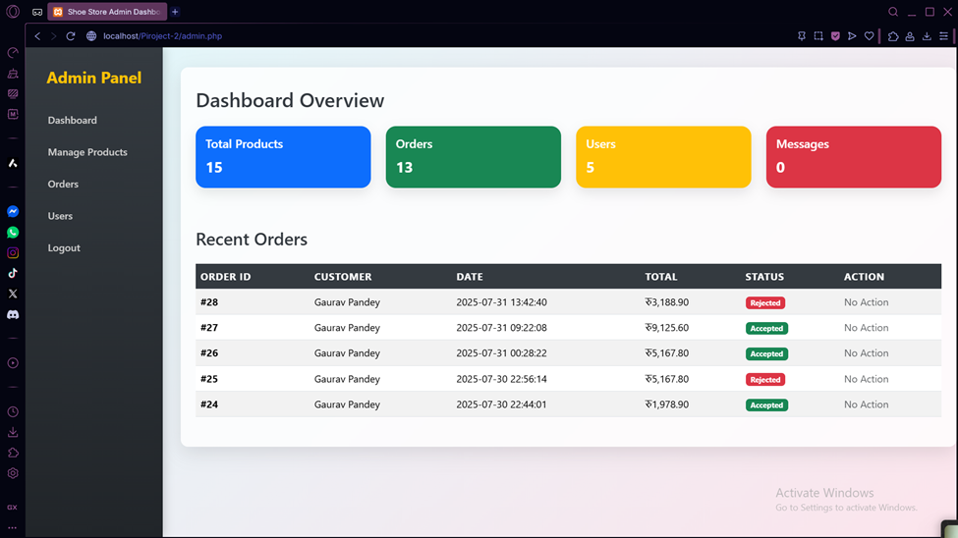
Testing AND DEMONSTRATION
ADMIN DASHBOARD

Slide 20
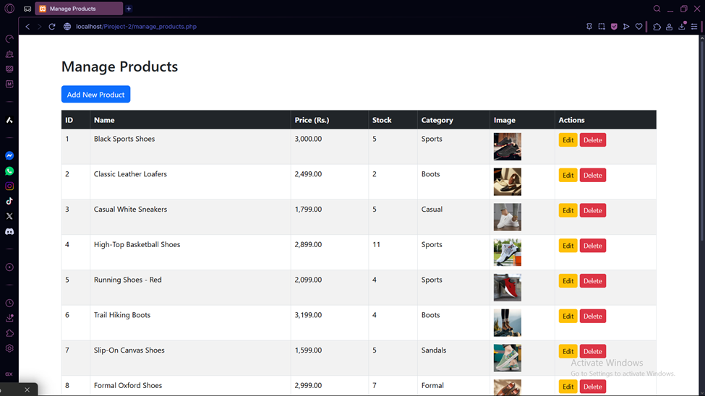
Testing AND DEMONSTRATION
ADMIN DASHBOARD

Slide 21
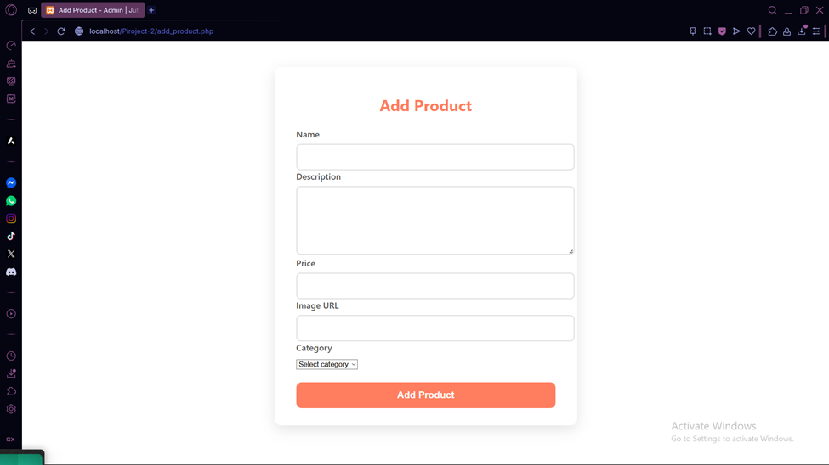
Testing AND DEMONSTRATION
ADMIN DASHBOARD

Slide 22
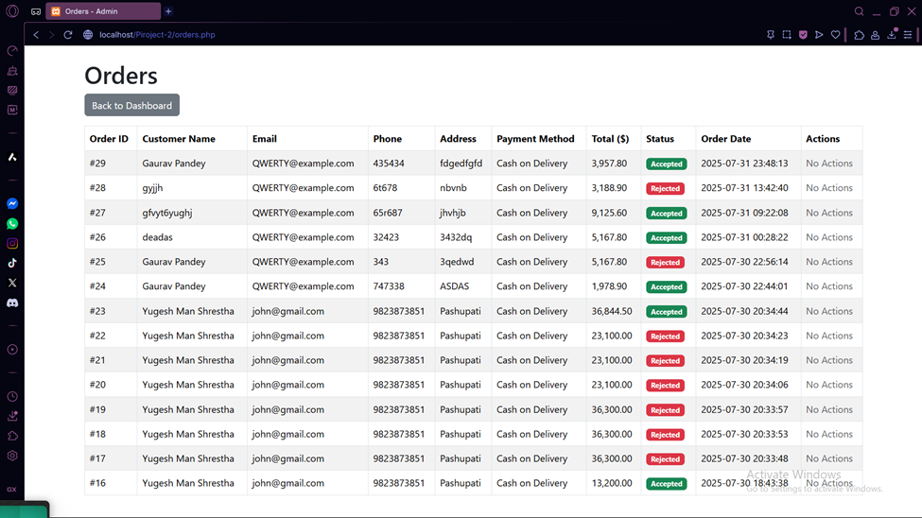
Testing AND DEMONSTRATION
ADMIN DASHBOARD

Slide 23
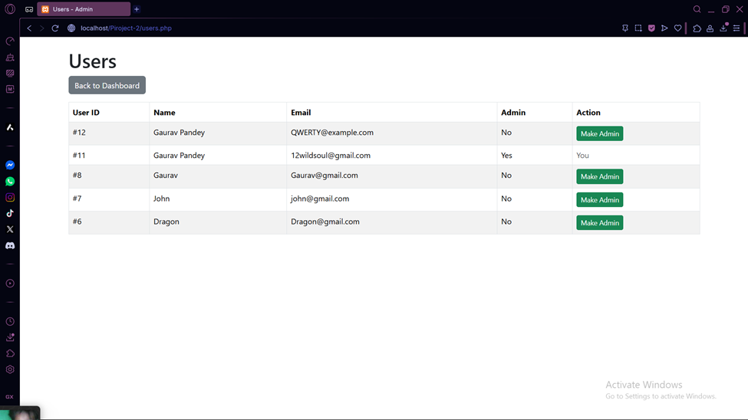
Testing AND DEMONSTRATION
ADMIN DASHBOARD

Slide 24

coNCLUSION AND
FUTURE ENHANCEMENT
Future Enhancements
Integrate payment gateways like Khalti/eSewa.
Add delivery tracking system.
Implement customer review & rating features.
Enable wishlist and save-for-later.
Launch Android/iOS mobile app.
Conclusion
“Jutta Sansaar” delivers a specialized footwear e-commerce experience.
Helps local businesses shift online effectively.
Secure, scalable, and user-focused design.
System ensures security, modularity, and scalability for future growth.

